Slide 1
Analyzing Classical Ciphers with Machine Learning
Aaron Smith and (Gavin) Zizhen Huang

Slide 2
Original goal of this project
Use machine learning on different ciphertexts to see what can be discovered about the plaintext and the cipher.
One minor goal is to crack the ciphertext (i.e. to decrypt it a reasonable amount).
Another goal is to uncover what cipher was used to produce a particular ciphertext.

Slide 3
Ciphers Considered
Shift Cipher
Columnar Transposition Cipher
Vigenere Cipher
Playfair Cipher
Hill Cipher

Slide 4
Data Collection
Programmed each cipher in Python
Used the ciphers to generate large datasets
Each run-through of the cipher, the key is randomized and random plaintext is read from the brown corpus
For each cipher, 10000 ciphertext samples were created for each length (100, 200, 300, 500, 1000) of characters

Slide 5
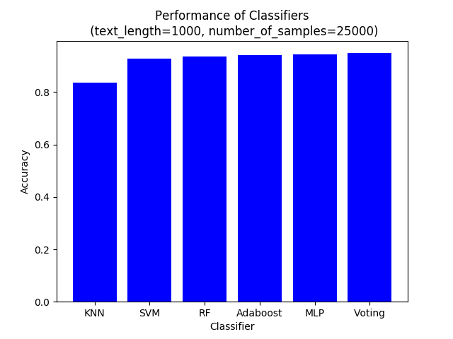
Classification Results
Used various machine learning techniques for classification: K-Nearest Neighbor (KNN), Support Vector Machine (SVM), Random Forest (RF), Adaboost, Neural Network (MLP), and Voting Classifier. All from the scikit-learn package.
Training and scoring vectors for all tests were created based on monogram counts (with the exception of the next slide).

Slide 6
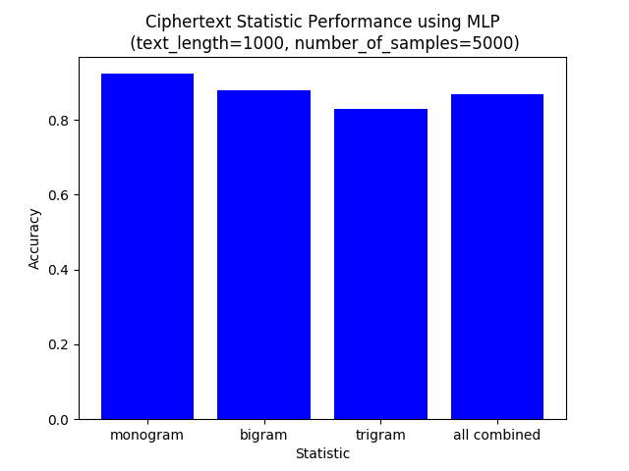
Classification Results
Models can be trained using different ciphertext statistics
We consider the following statistics: monogram counts (used on the previous page), bigram counts, and trigram counts.

Slide 7
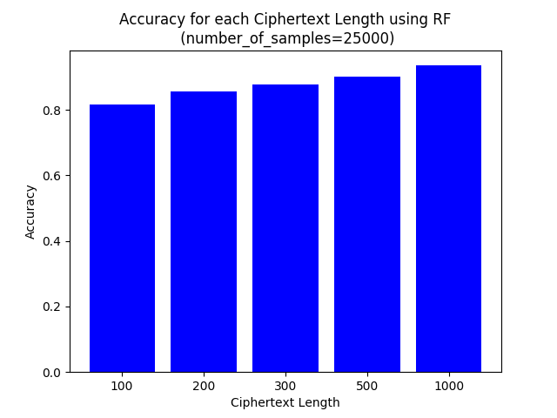
Classification Results
Accuracy of the models depends on the length of the ciphertext.

Slide 8
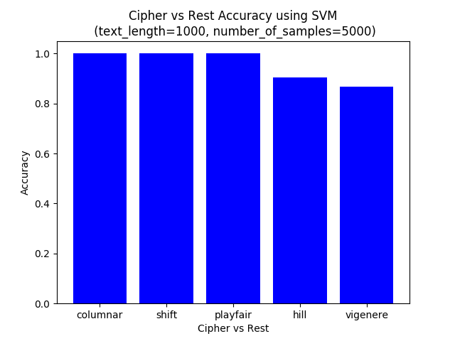
Classification Results
Some ciphers are easier to classify than others
Here we show the results of training 5 separate SVM’s, where each SVM is trained in a one vs rest scheme
What this means is that each SVM takes ciphertext data from all 5 ciphers, but 4 of the 5 types of ciphertexts are classified as +1, while the last type is classified as -1, creating a one vs rest scheme.

Slide 9
Classification Results
Why are some ciphertexts easier to classify than others? Let’s look at some of the properties of these ciphers.
Columnar is a transposition cipher… it doesn’t change monogram counts…
Shift is a monoalphabetic cipher… it will have similar monogram counts, just for different letters
Playfair is a bigram substitution cipher (i.e. pairs of letters are encrypted)
Hill is a polygraphic substitution cipher (i.e. blocks of letters are encrypted)
Vigenere is a polyalphabetic substitution cipher (i.e. uses multiple substitution alphabets)

Slide 10
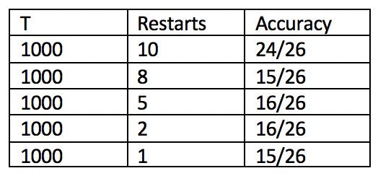
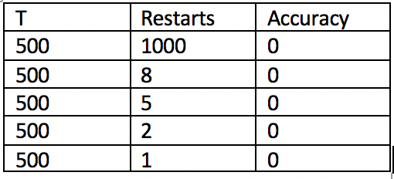
Decryption Results (Minor goal)
Simple substitution: Observation length that is < 1000 will take much more restarts to get some accurate results and it will take forever. However, we did confirm HMM (with English text digraph) works for simple substitution.
package used: our own HMM model code from HM2

Slide 11
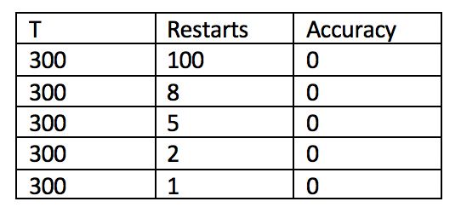
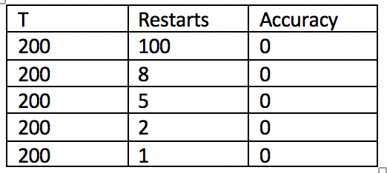

Slide 12

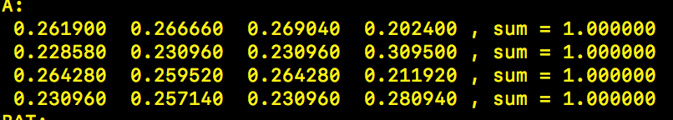
Decryption Results (Minor goal)
Vigenere Cipher using HMM (key length 7: BHZFFX, ciphertext length 1000 and 200 random restarts):
Package: our own HMM model
start with small N = 2
Not really helpful.
N = 4
Not deterministic. Need a bigger N.

Slide 13
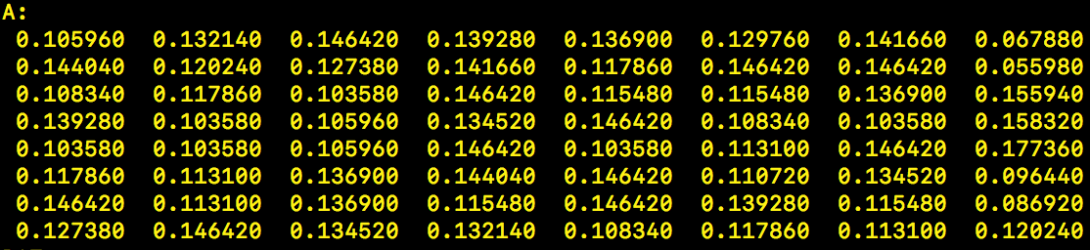
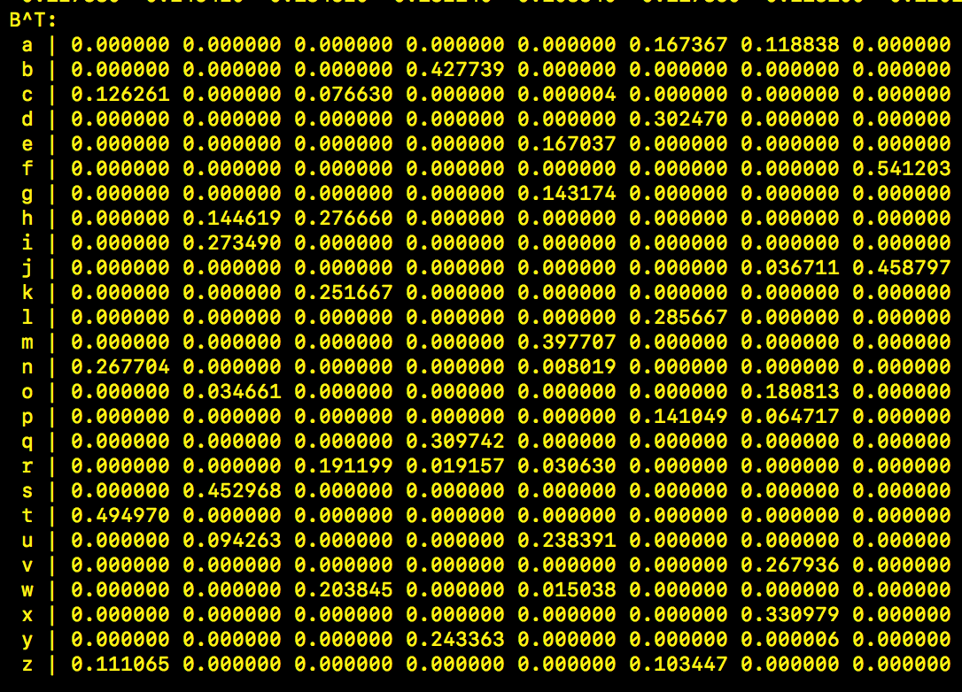
N = 8.
:(

Slide 14
Decryption Results (Minor goal)
LSTM on Vigenere Cipher: (Our goal does not aim to “crack” the cipher, but to see what our model can learn from the decryption algorithm: mapping from ciphertext to plaintext)
Nope, running out of luck :(

Slide 15
Conclusion
We performed several experiments with HMM with random starts. We are able to crack simple substitution ciphers, but we are not very lucky with the vigenere cipher. Our attempt to LSTM seems not quite promising.

Slide 16
Resources
https://en.wikipedia.org/wiki/Playfair_cipher
https://en.wikipedia.org/wiki/Substitution_cipher
https://en.wikipedia.org/wiki/Vigen%C3%A8re_cipher
https://en.wikipedia.org/wiki/Hill_cipher
https://greydanus.github.io/2017/01/07/enigma-rnn/
Introduction to Machine Learning with Applications in Information Security by Mark Stamp
https://scholarworks.sjsu.edu/cgi/viewcontent.cgi?article=1408&context=etd_projects
https://scikit-learn.org/stable/

